Slide 1
Chapter 14
Functional Dependencies and Normalization for Relational Databases

Slide 2

Transitive Functional Dependency
A functional dependency X → Y is a transitive functional dependency
if it can be derived from two FDs X → Z and Z → Y
E# | NAME | DEPT | MGR
1000 | John | CS | 1000
2000 | Kate | CS | 1000
3000 | Tony | MT | 3000
E# | NAME | DEPT | MGR

Slide 3
Third Normal Form
A relation schema is in third normal form (3NF) if it is in 2NF and no non-prime attribute is transitively dependent on the primary key
A relation can be decomposed into 3NF relations via the process of 3NF normalization
E# | NAME | DEPT | MGR
3NF Normalization
E# | ENAME | DEPT
DEPT | MGR

Slide 4
Normalizing into 3NF
2NF
2NF
S# | SNAME | STATUS | CITY |  | S# | P# | QTY
S# → SNAME, STATUS, CITY
CITY → STATUS
S#,P# → QTY
Which normal form are the relations in?
Is there any transitive dependency in a relation?
How to normalize it?
3NF Normalization
3NF
S# | SNAME | CITY
CITY | STATUS
S# | P# | QTY
S# → SNAME, STATUS
CITY → STATUS
Is there a transitive dependency?
Are the relations in 3NF?

Slide 5
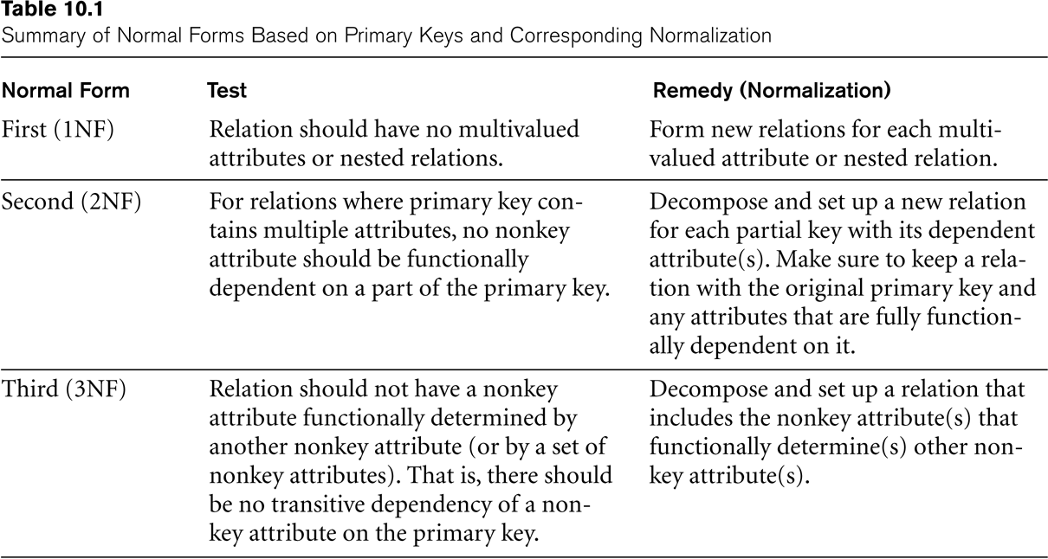
SUMMARY OF NORMAL FORMS based on Primary Keys

Slide 6
Normal Forms Defined Informally
1st normal form
  All attributes depend on the key
2nd normal form
  All attributes depend on the whole key
3rd normal form
  All attributes depend on nothing but the key
The above definitions consider the primary key only
A relation may have several candidate keys which are not considered in the definition.
Any attribute involved in a candidate key is a prime attribute
All other attributes are called non-prime attributes.

Slide 7
General Definition of 2NF
A relation schema is in second normal form (2NF) if every non-prime attribute is fully functionally dependent on every key
Is the relation in 2NF?
Candidate Key
Lots
Property# | County_Name | Lot# | Area | Price | Tax_Rate
FD1
FD2
FD3
FD4
FD3 violates 2NF.
Lots1
Property# | County_Name | Lot# | Area | Price
Lots2
County_name | Tax_rate
FD1
FD2
FD4
FD3

Slide 8
General Definition of Third Normal Form
A relation schema R is in third normal form (3NF) if whenever a FD X → A holds in R, then either:
  (a) X is a superkey of R, or
  (b) A is a prime attribute of R
Are the relations in 3NF?
Lots1
Property# | County_Name | Lot# | Area | Price
Lots2
County_name | Tax_rate
FD1
FD2
FD4
FD3
Area is not a superkey in Lots1
3NF Normalization
Lots1A
Property# | County_Name | Lot# | Area
Lots1B
Area | Price
FD1
FD2
FD4

Slide 9
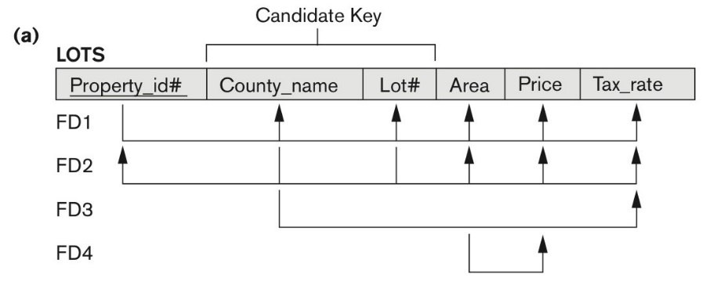
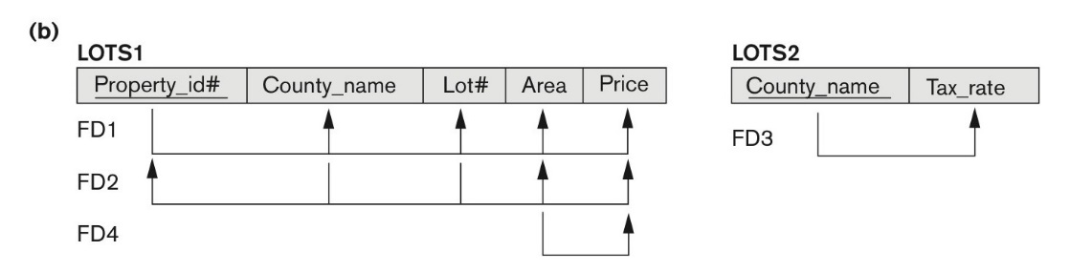
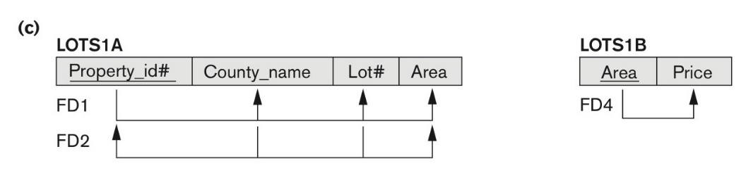
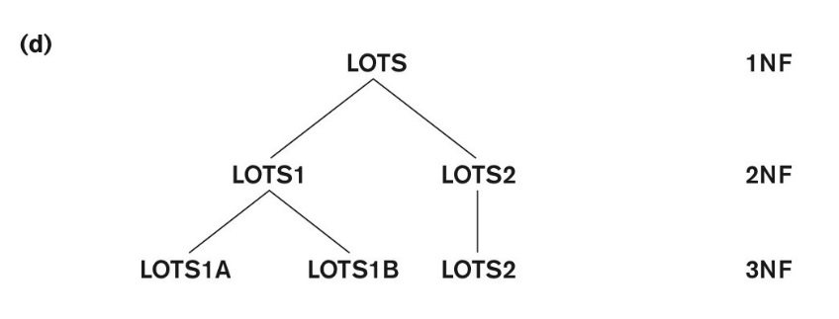
Normalization into 2NF and 3NF
Figure 14.12
(a) The LOTS relation with its functional dependencies FD1 through FD4.
(b) Decomposing into the 2NF relations LOTS1 and LOTS2.
(c) Decomposing LOTS1 into the 3NF relations LOTS1A and LOTS1B.
(d) Progressive normalization of LOTS into a 3NF design.

Slide 10
Interpreting the General Definition of 3NF
Consider the 2 conditions in the Definition of 3NF:
A relation schema R is in third normal form (3NF) if whenever a FD X → A holds in R, then either:
  (a) X is a superkey of R, or
  (b) A is a prime attribute of R
Condition (a) catches two types of violations :
one where a prime attribute functionally determines a non-prime attribute. This catches 2NF violations due to non-full functional dependencies.
second, where a non-prime attribute functionally determines a non-prime attribute. This catches 3NF violations due to a transitive dependency.

Slide 11
BCNF (Boyce-Codd Normal Form)
A relation schema R is in Boyce-Codd Normal Form (BCNF) if whenever an FD X → A holds in R, then X is a superkey of R
Each normal form is strictly stronger than the previous one
  Every 2NF relation is in 1NF
  Every 3NF relation is in 2NF
  Every BCNF relation is in 3NF
There exist relations that are in 3NF but not in BCNF
Hence BCNF is considered a stronger form of 3NF
The goal is to have each relation in BCNF (or 3NF)

Slide 12
BCNF
Lots1A
Property# | County_Name | Lot# | Area
2NF
FD1
FD2
FD5
BCNF Normalization
Lots1AX
Property# | Lot# | Area
Lots1AY
Area | County_Name
Is this a lossless decomposition?
Which Normal Form are they in?
If a relational is in BCNF, it is also in 3NF

Slide 13
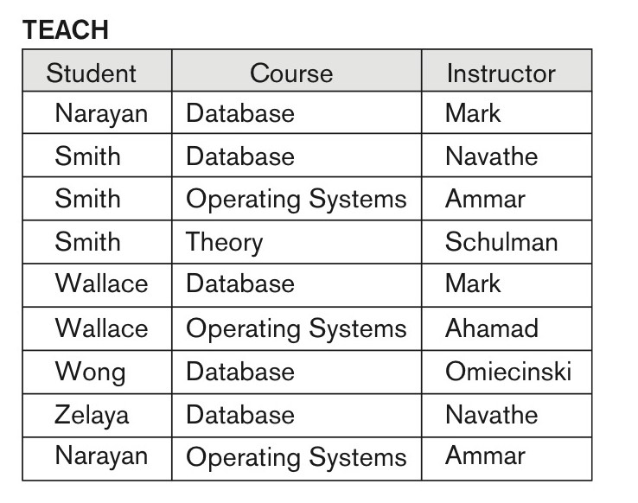
A relation in 3NF but not in BCNF
Figure 14.14
A relation TEACH that is in 3NF but not BCNF.
Student | Course | Instructor
FD1: Student,Course→Instructor
Which Normal Form is it in?
FD2: Instructor → Course
A relation NOT in BCNF should be decomposed
Student
Instructor
1NF?
2NF?
3NF?
BCNF?
Course

Slide 14
Achieving the BCNF by Decomposition
FD1: Student, Course → Instructor
FD2: Instructor → Course
Student | Course | Instructor
BCNF Normalization
Student | Instructor
Student | Course
Instructor | Course
Student | Course
Instructor | Course
Instructor | Student
All three decompositions will lose FD1.
We have to settle for sacrificing the functional dependency preservation.
Only the 3rd decomposition satisfies lossless join property

Slide 15
Armstrong's Inference Rules for FDs
Functional Dependency (FD): X → Y holds if for any two tuples t₁ and t₂ in any relation instance r(R): If t₁[X] = t₂[X] , then t₁[Y] = t₂[Y]
Given a set of FDs F, we can infer additional FDs X → Y that hold whenever the FDs in F hold F ⊨ X → Y
Armstrong's inference rules:
  IR1. (Reflexive) If Y subset-of X, then X → Y
  IR2. (Augmentation) If X → Y, then XZ → YZ
    (XZ stands for X ∪ Z)
  IR3. (Transitive) If X → Y and Y → Z, then X → Z
IR1, IR2, IR3 form a sound and complete set of inference rules
These are rules hold and all other rules that hold can be deduced from these

Slide 16
Inference Rules for FDs (1)
Student
S# | SNAME | AGE
1000 | John | 25
2000 | Kate | 24
3000 | Tony | 20
R1. (Reflexive) If X ⊇ Y, then X → Y
Proof of R1
  Let t₁ and t₂ be any two tuples in a relation r.
  Y is a subset of X (given)
  If t₁[X] = t₂[X]
  then t₁[Y] = t₂[Y] (Y is a subset of X)
  therefore X → Y (by FD Definition)
t₁,t₂
X= {SNAME, AGE}
Y= {SNAME}

Slide 17
Examples of FD constraints
Student |  |  |  | Grade |  |  |  | Course
S# | SNAME | AGE |  | S# | C# | MARK |  | C# | CNAME | LOC
1000 | John | 25 |  | 1000 | CS300 | 90 |  | CS300 | OS | ME300
2000 | Kate | 24 |  | 1000 | CS305 | 85 |  | CS305 | DB | UC231
3000 | Tony | 20 |  | 2000 | CS300 | 85 |  | MT230 | AL | TB300
R1. (Reflexive) If X ⊇ Y, then X → Y
Which of the following corresponds to this rule?
  S#,C# → MARK
  S#,C#,MARK → S#
  S#,C#,MARK → C#
  S#,C#,MARK → MARK
  S# → S#
  S#,C# → S#

Slide 18
Inference Rules for FDs (2)
R2. (Augmentation) If X → Y, then XZ → YZ
Proof of R2
  X → Y (given )
  then for any t₁ and t₂ in r
  if t₁[X] = t₂[X] we have t₁[Y] = t₂[Y] (by def)
  since t₁[XZ] = t₂[XZ] (given)
  we must have t₁[YZ] = t₂[YZ]
  It implies XZ → YZ (by def)
Student
S# | SNAME | AGE
1000 | John | 25
2000 | Kate | 24
3000 | Tony | 20
X= {S#}
Y= {Age}
Z= {SNAME}
t1,t2
XZ= {S#,SNAME}
YZ= {SNAME,AGE}

Slide 19
Inference Rules for FDs (3)
R3. (Transitive) If X → Y and Y → Z, then X → Z
Proof of R3:
  Because of X → Y (given)
  for any t₁ and t₂, if t₁[X] = t₂[X], then t₁[Y] = t₂[Y] (by Def X→Y)
  Because of Y → Z (given)
  and t₁[Y] = t₂[Y] (above)
  t₁[Z] = t₂[Z] (by Def Y→Z)
  Thus, if t₁[X] = t₂[X] (first) then we have t₁[Z] = t₂[Z] (last)
  That is, X → Z (by Def)
E# | ENAME | DEPT | MGR
E1 | John | CS | E1
E2 | Kate | CS | E1
E3 | Kate | CS | E1
X= {E#}
Y= {DEPT}
Z= {MGR}

Slide 20
Inference Example
  R0. ⊨ X → XX
  R1. (Reflexive) X ⊇ Y ⊨ X → Y
  R2. (Augmentation) X → Y ⊨ XZ → YZ
  R3. (Transitive) X → Y and Y → Z | = X → Z
Use rules R0, R1, R2, R3 to prove the following:
X → YZ ⊨ X → Y, X → Z
S# → SNAME AGE ⊨ S# → SNAME, S# → AGE
Proof
  X → YZ (given)
  YZ → Y (R1)
  X → Y (R3)
Student
S# | SNAME | AGE
1000 | John | 25
2000 | Kate | 24
3000 | Tony | 20
X= S# Y= SNAME Z= AGE
YZ = {SNAME, AGE}

Slide 21
Inference Example 2
  R0. ⊨ X → XX
  R1. (Reflexive) X ⊇ Y ⊨ X → Y
  R2. (Augmentation) X → Y ⊨ XZ → YZ
  R3. (Transitive) X → Y and Y → Z ⊨ X → Z
Use rules R0, R1, R2, R3 to prove the following:
X → Y, X → Z ⊨ X → YZ
S# → SNAME, S# → AGE ⊨ S# → {SNAME, AGE}
Proof
  X → Y, X → Z (given)
  X → XX (R0)
  XX → XY (adding X to both side of X → Y and Rule R2)
  XY → YZ (adding Y to both side of Y → Z and Rule R2)
  X → YZ (R3)

Slide 22
Inference Example 3
  R0. ⊨ X → XX
  R1. (Reflexive) X ⊇ Y ⊨ X → Y
  R2. (Augmentation) X → Y ⊨ XZ → YZ
  R3. (Transitive) X → Y and Y → Z ⊨ X → Z
Use rules R0, R1, R2, R3 to prove the following:
X → Y, WY → Z ⊨ WX → Z
Proof
  X → Y, WY → Z (given)
  WX → WY (R2)
  WX → Z (R3)

Slide 23
Inference Example 4
  R0. ⊨ X → XX
  R1. (Reflexive) X ⊇ Y ⊨ X → Y
  R2. (Augmentation) X → Y ⊨ XZ → YZ
  R3. (Transitive) X → Y and Y → Z ⊨ X → Z
Use rules R0, R1, R2, R3 to prove the following:
W → Y, X → Z ⊨ WX → Y
Proof
  W → Y (given)
  WX → XY (R2)
  XY → Y (R1)
  WX → Y (R3)
  Note X→XX is not used here

Slide 24
Inference Example 5
  R0. ⊨ X → XX
  R1. (Reflexive) X ⊇ Y ⊨ X → Y
  R2. (Augmentation) X → Y ⊨ XZ → YZ
  R3. (Transitive) X → Y and Y → Z ⊨ X → Z
Use rules R0, R1, R2, R3 to prove the following:
X → Y, Z subseteq Y ⊨ X → Z
Proof
  X → Y (given)
  Y → Z (Z is a subset of Y and R1)
  X → Z (R3)

Slide 25
Inference Example 6
  R0. ⊨ X → XX
  R1. (Reflexive) X ⊇ Y ⊨ X → Y
  R2. (Augmentation) X → Y ⊨ XZ → YZ
  R3. (Transitive) X → Y and Y → Z ⊨ X → Z
Use rules R0, R1, R2, R3 to prove the following:
X → Y, XY → Z ⊨ X → Z
Proof
  X → XX (R0)
  X → Y (given)
  XX → XY (R2)
  X → XY (R3)
  XY → Z (given)
  X → Z (R3)

Slide 26
Disproval Example 1
Def: X → Y holds if for any two tuples t₁ and t₂ in any relation instance r(R): If t₁[X] = t₂[X] , then t₁[Y] = t₂[Y]
Disprove a FD just need to show FD is violated with examples
Example
  ⊨ X → Y
Disproof
X | Y
John | 1234
John | 2345

Slide 27
Disproval Example 2
Def: X → Y holds if for any two tuples t₁ and t₂ in any relation instance r(R): If t₁[X] = t₂[X] , then t₁[Y] = t₂[Y]
Disprove a FD just need to show FD is violated with examples
Example
X → Z, Y → Z ⊨ X → Y
Disproof
  Need to give an example relation that satisfies X→Z, Y → Z
  but not X → Y
X | Y | Z
x₁ | y₁ | z₁
x₁ | y₂ | z₁

Slide 28
Disproval Example 3
Def: X → Y holds if for any two tuples t₁ and t₂ in any relation instance r(R): If t₁[X] = t₂[X] , then t₁[Y] = t₂[Y]
Disprove a FD just need to show FD is violated with examples
Example
XY → Z, Y → W ⊨ XW → Z
Disproof
  Need to give an example relation that satisfies XY → Z, Y → W
  but not XW → Z
X | W | Y | Z
x₁ | w₁ | y₁ | z₁
x₁ | w₁ | y₂ | z₂

Slide 29
Disproval Example 4
Def: X → Y holds if for any two tuples t₁ and t₂ in any relation instance r(R): If t₁[X] = t₂[X] , then t₁[Y] = t₂[Y]
Disprove a FD just need to show FD is violated with examples
Example
X → Y ⊨ Y → Z
Disproof
  Need to give an example relation that satisfies X→ Y
  but not Y → Z
X | Y | Z
x₁ | y₁ | z₁
x₂ | y₁ | z₂

Slide 30
Closure
Closure of a set F of FDs is the set F⁺ of all FDs that can be inferred from F
Closure of a set of attributes X with respect to F is the set X⁺ of all attributes that are functionally determined by X
X⁺ can be calculated by repeatedly applying R1, R2, R3 using the FDs in F

Slide 31
2.3 Equivalence of Sets of FDs
Two sets of FDs F and G are equivalent if:
  Every FD in F can be inferred from G, and
  Every FD in G can be inferred from F
  Hence, F and G are equivalent if F⁺ =G⁺
Definition (Covers):
  F covers G if every FD in G can be inferred from F
    (i.e., if G⁺ subset-of F⁺)
F and G are equivalent if F covers G and G covers F
There is an algorithm for checking equivalence of sets of FDs

Slide 32
2.4 Minimal Sets of FDs (1)
A set of FDs is minimal if it satisfies the following conditions:
  Every dependency in F has a single attribute for its RHS.
  We cannot remove any dependency from F and have a set of dependencies that is equivalent to F.
  We cannot replace any dependency X → A in F with a dependency Y → A, where Y proper-subset-of X ( Y subset-of X) and still have a set of dependencies that is equivalent to F.

Slide 33
Minimal Sets of FDs (2)
Every set of FDs has an equivalent minimal set
There can be several equivalent minimal sets
There is no simple algorithm for computing a minimal set of FDs that is equivalent to a set F of FDs
To synthesize a set of relations, we assume that we start with a set of dependencies that is a minimal set
  E.g., see algorithms 11.2 and 11.4

